Slide 1
Quadratic probing

Slide 2
Outline
This topic covers quadratic probing
Similar to linear probing
Does not step forward one step at a time
Primary clustering no longer occurs
Affected by secondary clustering

Slide 3
Background
Linear probing:
Look at bins k, k + 1, k + 2, k + 3, k + 4, …
Primary clustering

Slide 4
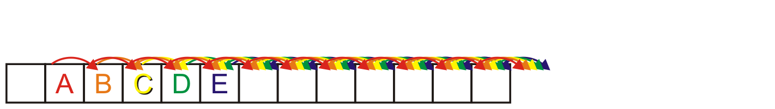
Background
Linear probing causes primary clustering
All entries follow the same search pattern for bins:
int initial = hash_M( x.hash(), M );
for ( int k = 0; k < M; ++k ) {
bin = (initial + k) % M;
// ...
}

Slide 5
Description
Quadratic probing suggests moving forward by different amounts
For example,
int initial = hash_M( x.hash(), M );
for ( int k = 0; k < M; ++k ) {
bin = (initial + k*k) % M;
}

Slide 6
Description
Problem:
Will initial + k*k step through all of the bins?
Here, the array size is 10:
M = 10;
initial = 5
for ( int k = 0; k <= M; ++k ) {
std::cout << (initial + k*k) % M << ' ';
}
The output is
5 6 9 4 1 0 1 4 9 6 5

Slide 7
Description
Problem:
Will initial + k*k step through all of the bins?
Now the array size is 12:
M = 12;
initial = 5
for ( int k = 0; k <= M; ++k ) {
std::cout << (initial + k*k) % M << ' ';
}
The output is now
5 6 9 2 9 6 5 6 9 2 9 6 5

Slide 8
Making M Prime
If we make the table size M = p a prime number quadratic probing is guaranteed to iterates through entries
Problems:
All operations must be done using %
Cannot use &, <<, or >>
The modulus operator % is relatively slow
Doubling the number of bins is difficult:
What is the next prime after 2 × 263?
Warning: most text books stop here!
– Never use a prime table size if at all possible

Slide 9
Generalization
More generally, we could consider an approach like:
int initial = hash_M( x.hash(), M );
for ( int k = 0; k < M; ++k ) {
bin = (initial + c1*k + c2*k*k) % M;
}

Slide 10
Using M = 2^{m}
If we ensure M = 2^{m} then choose
c₁ = c₂ = ½
int initial = hash_M( x.hash(), M );
for ( int k = 0; k < M; ++k ) {
bin = (initial + (k + k*k)/2) % M;
}
Note that k + k*k is always even
The growth is still Θ(k²)
This guarantees that all M entries are visited before the pattern repeats
This only works for powers of two

Slide 11
Using M = 2^{m}
For example:
Use an array size of 16:
M = 16;
initial = 5
for ( int k = 0; k <= M; ++k ) {
std::cout << (initial + (k + k*k)/2) % M << ' ';
}
The output is now
5 6 8 11 15 4 10 1 9 2 12 7 3 0 14 13 13

Slide 12
Using M = 2^{m}
There is an even easier means of calculating this approach
int bin = hash_M( x.hash(), M );
for ( int k = 0; k < M; ++k ) {
bin = (bin + k) % M;
}
Recall that , so just keep adding the next highest value

Slide 13
Example
Consider a hash table with M = 16 bins
Given a 2-digit hexadecimal number:
The least-significant digit is the primary hash function (bin)
Example: for 6B7A₁₆ , the initial bin is A

Slide 14
Example
Insert these numbers into this initially empty hash table
9A, 07, AD, 88, BA, 80, 4C, 26, 46, C9, 32, 7A, BF, 9C
0 | 1 | 2 | 3 | 4 | 5 | 6 | 7 | 8 | 9 | A | B | C | D | E | F

Slide 15
Example
Start with the first four values:
9A, 07, AD, 88
0 | 1 | 2 | 3 | 4 | 5 | 6 | 7 | 8 | 9 | A | B | C | D | E | F

Slide 16
Example
Start with the first four values:
9A, 07, AD, 88
0 | 1 | 2 | 3 | 4 | 5 | 6 | 7 | 8 | 9 | A | B | C | D | E | F
 |  |  |  |  |  |  | 07 | 88 |  | 9A |  |  | AD

Slide 17
Example
Next we must insert BA
0 | 1 | 2 | 3 | 4 | 5 | 6 | 7 | 8 | 9 | A | B | C | D | E | F
 |  |  |  |  |  |  | 07 | 88 |  | 9A |  |  | AD

Slide 18
Example
Next we must insert BA
The next bin is empty
0 | 1 | 2 | 3 | 4 | 5 | 6 | 7 | 8 | 9 | A | B | C | D | E | F
 |  |  |  |  |  |  | 07 | 88 |  | 9A | BA |  | AD

Slide 19
Example
Next we are adding 80, 4C, 26
0 | 1 | 2 | 3 | 4 | 5 | 6 | 7 | 8 | 9 | A | B | C | D | E | F
 |  |  |  |  |  |  | 07 | 88 |  | 9A | BA |  | AD

Slide 20
Example
Next we are adding 80, 4C, 26
All the bins are empty—simply insert them
0 | 1 | 2 | 3 | 4 | 5 | 6 | 7 | 8 | 9 | A | B | C | D | E | F
80 |  |  |  |  |  | 26 | 07 | 88 |  | 9A | BA | 4C | AD

Slide 21
Example
Next, we must insert 46
0 | 1 | 2 | 3 | 4 | 5 | 6 | 7 | 8 | 9 | A | B | C | D | E | F
80 |  |  |  |  |  | 26 | 07 | 88 |  | 9A | BA | 4C | AD

Slide 22
Example
Next, we must insert 46
Bin 6 is occupied
Bin 6 + 1 = 7 is occupied
Bin 7 + 2 = 9 is empty
0 | 1 | 2 | 3 | 4 | 5 | 6 | 7 | 8 | 9 | A | B | C | D | E | F
80 |  |  |  |  |  | 26 | 07 | 88 | 46 | 9A | BA | 4C | AD

Slide 23
Example
Next, we must insert C9
0 | 1 | 2 | 3 | 4 | 5 | 6 | 7 | 8 | 9 | A | B | C | D | E | F
80 |  |  |  |  |  | 26 | 07 | 88 | 46 | 9A | BA | 4C | AD

Slide 24
Example
Next, we must insert C9
Bin 9 is occupied
Bin 9 + 1 = A is occupied
Bin A + 2 = C is occupied
Bin C + 3 = F is empty
0 | 1 | 2 | 3 | 4 | 5 | 6 | 7 | 8 | 9 | A | B | C | D | E | F
80 |  |  |  |  |  | 26 | 07 | 88 | 46 | 9A | BA | 4C | AD |  | C9

Slide 25
Example
Next, we insert 32
Bin 2 is unoccupied
0 | 1 | 2 | 3 | 4 | 5 | 6 | 7 | 8 | 9 | A | B | C | D | E | F
80 |  | 32 |  |  |  | 26 | 07 | 88 | 46 | 9A | BA | 4C | AD |  | C9

Slide 26
Example
Next, we insert 7A
Bin A is occupied
Bins A + 1 = B, B + 2 = D and D + 3 = 0 are occupied
Bin 0 + 4 = 4 is empty
0 | 1 | 2 | 3 | 4 | 5 | 6 | 7 | 8 | 9 | A | B | C | D | E | F
80 |  | 32 |  | 7A |  | 26 | 07 | 88 | 46 | 9A | BA | 4C | AD |  | C9

Slide 27
Example
Next, we insert BF
Bin F is occupied
Bins F + 1 = 0 and 0 + 2 = 2 are occupied
Bin 2 + 3 = 5 is empty
0 | 1 | 2 | 3 | 4 | 5 | 6 | 7 | 8 | 9 | A | B | C | D | E | F
80 |  | 32 |  | 7A | BF | 26 | 07 | 88 | 46 | 9A | BA | 4C | AD |  | C9

Slide 28
Example
Finally, we insert 9C
Bin C is occupied
Bins C + 1 = D, D + 2 = F, F + 3 = 2, 2 + 4 = 6 and 6 + 5 = B are occupied
Bin B + 6 = 1 is empty
0 | 1 | 2 | 3 | 4 | 5 | 6 | 7 | 8 | 9 | A | B | C | D | E | F
80 | 9C | 32 |  | 7A | BF | 26 | 07 | 88 | 46 | 9A | BA | 4C | AD |  | C9

Slide 29
Example
Having completed these insertions:
The load factor is λ = 14/16 = 0.875
The average number of probes is 32/14 ≈ 2.29
0 | 1 | 2 | 3 | 4 | 5 | 6 | 7 | 8 | 9 | A | B | C | D | E | F
80 | 9C | 32 |  | 7A | BF | 26 | 07 | 88 | 46 | 9A | BA | 4C | AD |  | C9

Slide 30
Resizing the array
To double the capacity of the array, each value must be rehashed
80, 9C, 32, 7A, BF, 26, 07, 88 may be immediately placed
We use the least-significant five bits for the initial bin
If the next least-significant digit is
Even, use bins 0 – F
Odd, use bins 10 – 1F
0 | 1 | 2 | 3 | 4 | 5 | 6 | 7 | 8 | 9 | A | B | C | D | E | F | 10 | 11 | 12 | 13 | 14 | 15 | 16 | 17 | 18 | 19 | 1A | 1B | 1C | 1D | 1E | 1F
80 |  |  |  |  |  | 26 | 07 | 88 |  |  |  |  |  |  |  |  |  | 32 |  |  |  |  |  |  |  | 7A |  | 9C |  |  | BF

Slide 31
Resizing the array
To double the capacity of the array, each value must be rehashed
46 results in a collision
We place it in bin 9
0 | 1 | 2 | 3 | 4 | 5 | 6 | 7 | 8 | 9 | A | B | C | D | E | F | 10 | 11 | 12 | 13 | 14 | 15 | 16 | 17 | 18 | 19 | 1A | 1B | 1C | 1D | 1E | 1F
80 |  |  |  |  |  | 26 | 07 | 88 | 46 |  |  |  |  |  |  |  |  | 32 |  |  |  |  |  |  |  | 7A |  | 9C |  |  | BF

Slide 32
Resizing the array
To double the capacity of the array, each value must be rehashed
9A results in a collision
We place it in bin 1B
0 | 1 | 2 | 3 | 4 | 5 | 6 | 7 | 8 | 9 | A | B | C | D | E | F | 10 | 11 | 12 | 13 | 14 | 15 | 16 | 17 | 18 | 19 | 1A | 1B | 1C | 1D | 1E | 1F
80 |  |  |  |  |  | 26 | 07 | 88 | 46 |  |  |  |  |  |  |  |  | 32 |  |  |  |  |  |  |  | 7A | 9A | 9C |  |  | BF

Slide 33
Resizing the array
To double the capacity of the array, each value must be rehashed
BA also results in a collision
We place it in bin 1D
0 | 1 | 2 | 3 | 4 | 5 | 6 | 7 | 8 | 9 | A | B | C | D | E | F | 10 | 11 | 12 | 13 | 14 | 15 | 16 | 17 | 18 | 19 | 1A | 1B | 1C | 1D | 1E | 1F
80 |  |  |  |  |  | 26 | 07 | 88 | 46 |  |  |  |  |  |  |  |  | 32 |  |  |  |  |  |  |  | 7A | 9A | 9C | BA |  | BF

Slide 34
Resizing the array
To double the capacity of the array, each value must be rehashed
4C and AD don’t cause collisions
0 | 1 | 2 | 3 | 4 | 5 | 6 | 7 | 8 | 9 | A | B | C | D | E | F | 10 | 11 | 12 | 13 | 14 | 15 | 16 | 17 | 18 | 19 | 1A | 1B | 1C | 1D | 1E | 1F
80 |  |  |  |  |  | 26 | 07 | 88 | 46 |  |  | 4C | AD |  |  |  |  | 32 |  |  |  |  |  |  |  | 7A | 9A | 9C | BA |  | BF

Slide 35
Resizing the array
To double the capacity of the array, each value must be rehashed
Finally, C9 causes a collision
We place it in bin A
0 | 1 | 2 | 3 | 4 | 5 | 6 | 7 | 8 | 9 | A | B | C | D | E | F | 10 | 11 | 12 | 13 | 14 | 15 | 16 | 17 | 18 | 19 | 1A | 1B | 1C | 1D | 1E | 1F
80 |  |  |  |  |  | 26 | 07 | 88 | 46 | C9 |  | 4C | AD |  |  |  |  | 32 |  |  |  |  |  |  |  | 7A | 9A | 9C | BA |  | BF

Slide 36
Resizing the array
To double the capacity of the array, each value must be rehashed
The load factor is λ = 14/32 = 0.4375
The average number of probes is 20/14 ≈ 1.43
0 | 1 | 2 | 3 | 4 | 5 | 6 | 7 | 8 | 9 | A | B | C | D | E | F | 10 | 11 | 12 | 13 | 14 | 15 | 16 | 17 | 18 | 19 | 1A | 1B | 1C | 1D | 1E | 1F
80 |  |  |  |  |  | 26 | 07 | 88 | 46 | C9 |  | 4C | AD |  |  |  |  | 32 |  |  |  |  |  |  |  | 7A | 9A | 9C | BA |  | BF

Slide 37
Erase
Can we erase an object like we did with linear probing?
Consider erasing 9A from this table
There are M – 1 possible locations where an object which could have occupied a position could be located
Instead, we will use the concept of lazy deletion
Mark a bin as ERASED; however, when searching, treat the bin as occupied and continue
We must have a separate ternary-valued flag for each bin
0 | 1 | 2 | 3 | 4 | 5 | 6 | 7 | 8 | 9 | A | B | C | D | E | F
80 | 21 |  | 43 |  |  | 76 |  |  |  | 9A |  |  |  |  | 50

Slide 38
Erase
If we erase AD, we must mark that bin as erased
0 | 1 | 2 | 3 | 4 | 5 | 6 | 7 | 8 | 9 | A | B | C | D | E | F
80 | 9C | 32 |  | 7A | BF | 26 | 07 | 88 | 46 | 9A | BA | 4C | AD |  | C9

Slide 39
Find
When searching, it is necessary to skip over this bin
For example, find AD: D, E
find 5C: C, D, F, 2, 5, 9, F, 6, E
0 | 1 | 2 | 3 | 4 | 5 | 6 | 7 | 8 | 9 | A | B | C | D | E | F
80 | 9C | 32 |  | 7A | BF | 26 | 07 | 88 | 46 | 9A | BA | 4C | AD |  | C9

Slide 40
Modified insertion
We must modify insert, as we may place new items into either
Unoccupied bins
Erased bins

Slide 41
Implementation
Storing three states can be achieved using an enumerated type:
enum bin_state_t {
UNOCCUPIED,
OCCUPIED,
ERASED
};
Now we can declare and initialize arrays:
bin_state_t state[M];
for ( int i = 0; i < M; ++i ) {
state[i] = UNOCCUPIED;
}

Slide 42
Multiple insertions and erases
One problem which may occur after multiple insertions and removals is that numerous bins may be marked as ERASED
In calculating the load factor, an ERASED bin is equivalent to an OCCUPIED bin
This will increase our run times…

Slide 43
Multiple insertions and erases
We can easily track the number of bins which are:
UNOCCUPIED
OCCUPIED
ERASED
by updating appropriate counters
If the load factor λ grows too large, we have two choices:
If the load factor due to occupied bins is too large, double the table size
Otherwise, rehash all of the objects currently in the hash table

Slide 44
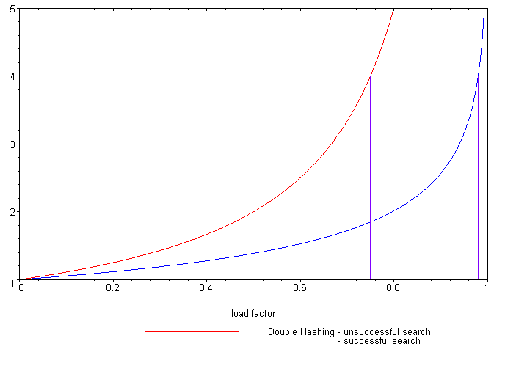
Expected number of probes
Load Factor (λ)
Unsuccessful search
Successful search
Reference: Knuth, The Art of Computer Programming,
Vol. 3, 2nd Ed., 1998, Addison Wesley, p. 530.
It is possible to calculate the expected number of probes for quadratic probing, again, based on the load factor:
Successful searches:
Unsuccessful searches:
When λ = 2/3, we requires 1.65 and 3 probes, respectively
Linear probing required 3 and 5 probes, respectively

Slide 45
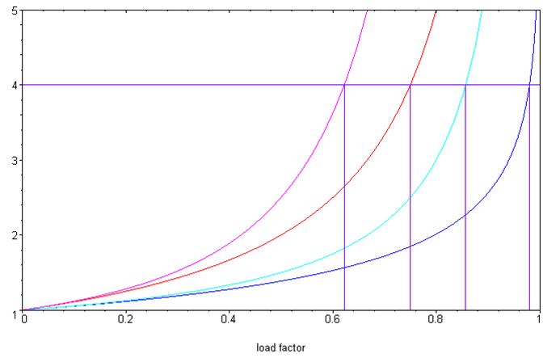
Quadratic probing versus linear probing
Comparing the two:
Linear probing
Unsuccessful search
Successful search
Quadratic probing
Unsuccessful search
Successful search
Examined Bins
Load Factor (λ)

Slide 46
Cache misses
One benefit of quadratic probing:
The first few bins examined are close to the initial bin
It is unlikely to reference a section of the array far from the initial bin
Modern computers use caches
4 KiB pages of main memory are copied into faster caches
Pages are only brought into the cache when referenced
Accesses close to the initial bin are likely to reference the same page

Slide 47
Secondary clustering
One weakness with quadratic problem
It reverts to linear probing if many of the hash function is not random
Objects placed in the same bin will follow the same sequence

Slide 48
Summary
In this topic, we have looked at quadratic probing:
An open addressing technique
Steps forward by a quadratically growing steps
Insertions and searching are straight forward
Removing objects is more complicated: use lazy deletion
Still subject to secondary probing

Slide 49
References
Wikipedia, http://en.wikipedia.org/wiki/Quadratic_probing
[1] Cormen, Leiserson, and Rivest, Introduction to Algorithms, McGraw Hill, 1990.
[2] Weiss, Data Structures and Algorithm Analysis in C++, 3rd Ed., Addison Wesley.
These slides are provided for the ECE 250 Algorithms and Data Structures course. The material in it reflects Douglas W. Harder’s best judgment in light of the information available to him at the time of preparation. Any reliance on these course slides by any party for any other purpose are the responsibility of such parties. Douglas W. Harder accepts no responsibility for damages, if any, suffered by any party as a result of decisions made or actions based on these course slides for any other purpose than that for which it was intended.

